Slide 1

REPORTABLE INCIDENT REPORT
Delphi TVS Technologies Ltd,
Oragadam

Slide 2
INCIDENT DETAILS
Department : Heat Treatment
Process / Activity : DFP6 Hydraulic Head movement by Material
Handling Trolley (From HT to DFP6)
Injured person : Kalaiselvan A
CC.No : RS10171
Date & Shift : 03.08.2024 & 3rd shift
Incident Time : 1.25 AM

Slide 3
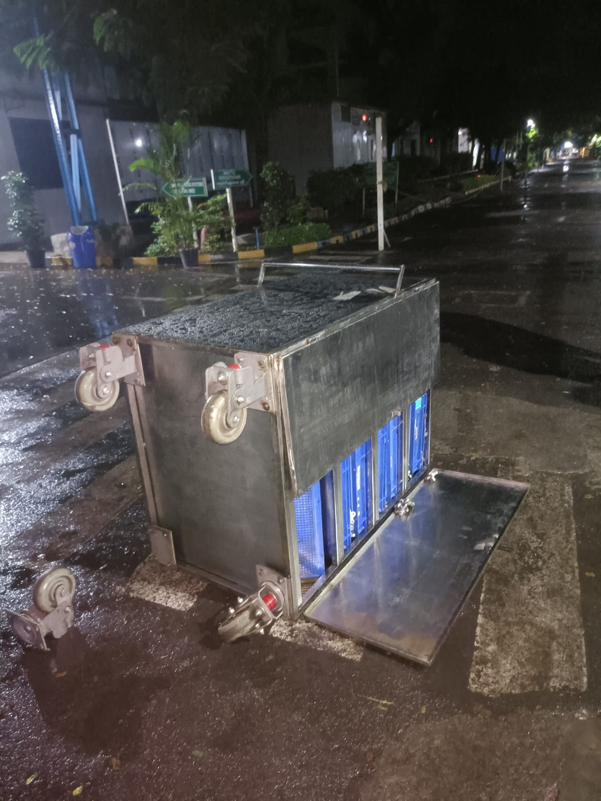
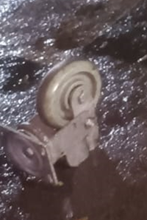
INCIDENT DESCRIPTION
At 1.15am, ArunPrakash S (FPD supervisor) informed the trainees Kalaiselvan and Murugan to move the DFP6 Hydraulic Head component loaded trolley by manually from Heat Treatment to DFP6 hard stage area.
Following the instructions , trainee Kalaisaelvan started moving the trolley from HT passing through Phase 1 building main gangway route and then through the main road passage.
While moving on,the rear end left wheel detached from the trolley and causing the trolley collapsed and so trainee attempted to balance the trolley from falling off.
During that time, the trolley completely fell on his right leg and resulted to bone fracture injury in his right leg with an open wound.
Component loaded trolley fell down while moving it
Detached trolley Wheel

Slide 4
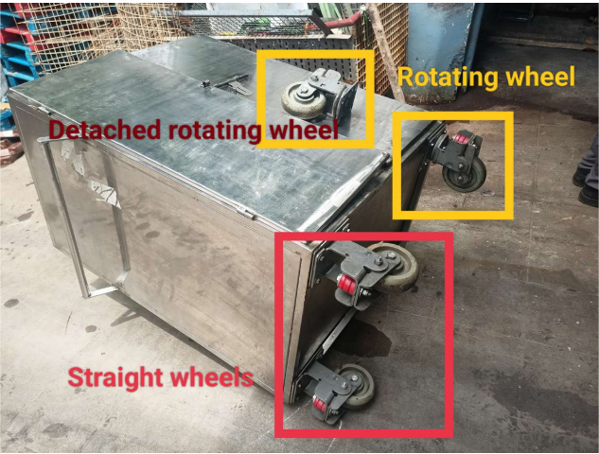
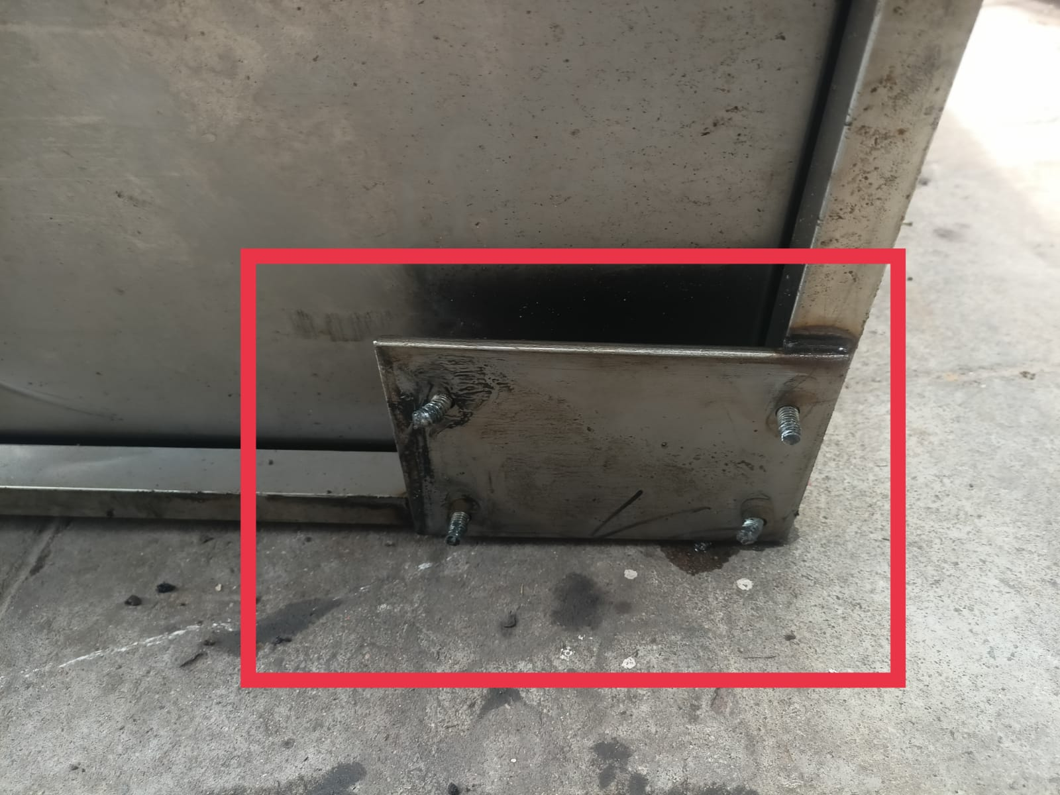
INCIDENT DESCRIPTION
Observations:
1)No Nuts (securing the wheel bolts with base plate) were observed.
2)Rotating wheels had been fixed in the rear end side of the trolley.(Should be at the front end side where handle is provided)
3)Material Handling Trolley with full load was moved manually by pushing the trolley by a single person.
4)Un even surfaces in the Road

Slide 5
ROOT CAUSE ANALYSIS
Injury
Trainee sustained bone fracture in his right leg
WHY 1
DFP6 hydraulic Head components loaded trolley collapsed and fell on his right leg while movement
WHY 2
One of the wheel (rear end left) in the trolley got detached
Bolt Nuts securing the Trolley wheel with base plate were in loose condition
WHY 3
Trolley condition monitoring and maintenance was not performed on this material handling trolley
WHY 4
No system to ensure for condtion monitoring and maintenance of Material Handling trolley
WHY 5

Slide 6
CORRECTIVE ACTION
Sl.No | Cause of Accident | Corrective Action | Resp | Target Date
1 | No system to ensure for condtion monitoring and maintenance of Material Handling trolley | A comprehensive SOP to be made for Material Handling Trollies on Safe usage, monitoring and maintenance | R.Gopu | 10.08.2024
 |  | FLM for Material Handling Trollies to be introduced | R.Gopu | 10.08.2024
 |  | PM for Material Handling Trollies to be done | D.Muthukumaran
2 | Component loaded trolleys with the huge capacity were handled manually | Criteria to be defined for movement of the material handling trollies based on Size and total weight (including parts) to decide the material handling by a)Manual movement and b)Material Handling Equipment (Forklift,Stacker,etc..) | R.Gopu | 17.08.2024

Slide 7
CORRECTIVE ACTION
Sl.No | Cause of Accident | Corrective Action | Resp | Target Date
3 | Trolley is stuck on the road because of the uneven road surface during its movement | Separate RCC flooring with smooth finishing to be provided in road only for trolley movement on both side of the road | TVS
4 | No incoming inspection is done for material handling trolleys before handing over to user department | 1. Incoming inspection to be done for all new material handling trolleys and storage facilities before handing over to user department(Along with FPD/EHS) 2. Handing over check sheet to be prepared and followed | N.Sairam
5 | Lack of Safety Awareness - Victim pushing the component loaded trolley | Awareness should be given to all trainees on how to handle the trolleys. "Always pull the trolley, do not push it. | M.Rajesh | 17.08.2024

Slide 8
Medical Treatment

